Slide 1
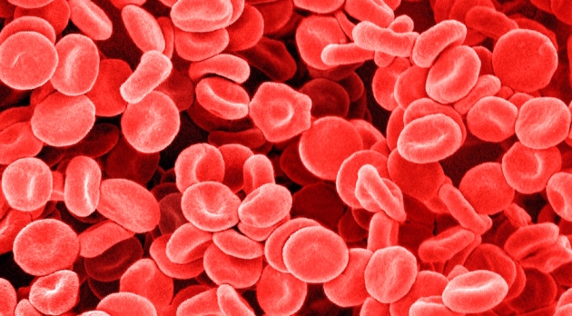
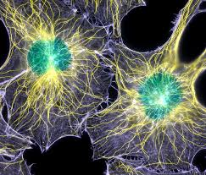
Question for the day:
What is a cell?
Make a list of all the cell types you can name.

Slide 2
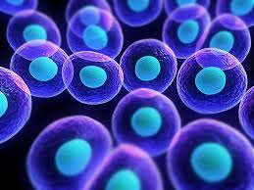
Goals for today
Finish CH 7 reading Q’s—due tomorrow!
DON’T SKIP QUESTION 11! I know it’s long. You can do it! Names and Functions of the major cell organelles: see p. 207 for help!

