Slide 1
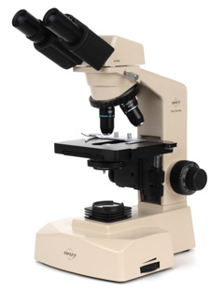
Microscope 101
Always carry a scope with two hands: One on the arm and one under the base.

Slide 2
Care of the microscope
Always use lens paper and alcohol
NEVER use paper towel, kleenex or any other materials on the scopes.
Be careful when moving scopes and switching slides or objectives.
You Break it, You Buy it!

Slide 3
Starting Checklist
Light is on
Rheostat is adjusted
Slide is clipped on stage (right-side up!)
Scanning lens (4x objective) is in place
Specimen is centered over the light opening
Focus the stage up first on low power

Slide 4
Condenser
Condenser Lens: A lens mounted in or below the stage whose purpose is to focus or condense the light onto the specimen. The higher power objective lenses have very tiny diameters and require concentrated light to work properly. By using a condenser lens you will increase the Illumination and resolution.

Slide 5
Resolution
Resolution: The ability of a lens system to show fine details of the object being observed. Higher resolution = more details.
Our microscopes have 4X, 10X, 40X and 100X resolution options

Slide 6
Diaphragm
Diaphragm: A glass disc placed under the stage on a high power microscope. By turning it, you can vary the amount of light passing through the stage opening. This will help to properly illuminate the specimen and increase contrast and resolution.

Slide 7
Field of View
Sometimes abbreviated "FOV", it is the diameter of the circle of light that you see when looking into a microscope. As the power gets greater, the field of view gets smaller. You can measure this by placing a clear metric ruler on the stage and counting the millimeters from one side to the other. Typically you will see about 4.5mm at 40X, 1.8mm at 100X, 0.45mm at 400X and 0.18mm at 1000X. See micrometer.

Slide 8
Prepared Slide
A flat glass or plastic rectangular plate that the specimen is placed on and glued shut. These will last for many years.

Slide 9
Wet Mount Slide
A flat glass or plastic rectangular plate that the specimen is placed on. It may have a depression or well to hold a few drops of liquid. After adding the specimen, cover with a glass coverslip.

Slide 10
Depth of Field
Depth of field (DOF) is the distance between the nearest and farthest objects in a scene that appear acceptably sharp in an image. Although a lens can precisely focus at only one distance at a time, the decrease in sharpness is gradual on each side of the focused distance, so that within the DOF, the unsharpness is imperceptible under normal viewing conditions.

Slide 11
Parfocality
Parfocal: This is a focus issue. When changing from one objective to another, the new image is already in focus or close enough so that you can refocus with only minor adjustments.

Slide 12
Calculating Magnification
Eyepiece power X Objective power
Example: A microscope has an eyepiece capable of magnifying an object 10 times its actual size and you’re using an objective lens with a power of 20X. What is the total magnification?

Slide 13
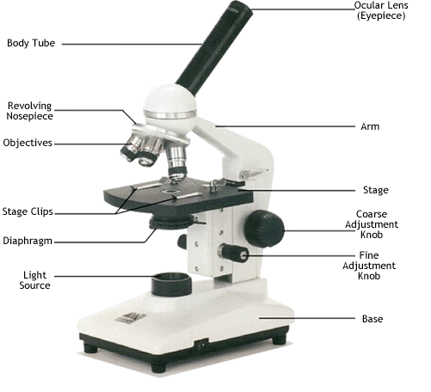

Slide 14
Microscope drawing rules
Pencil ONLY!
Use colored pencils if you see colors
Use a Ruler for drawing label lines
Print labels horizontally
DO NOT cross lines
Point to the center of the item
Use a compass for the field of view
Do not draw all the cells, just a few

Slide 15
