Slide 1
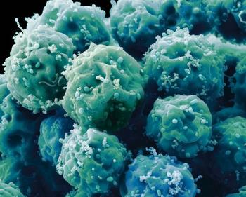
STEM CELLS

Slide 2
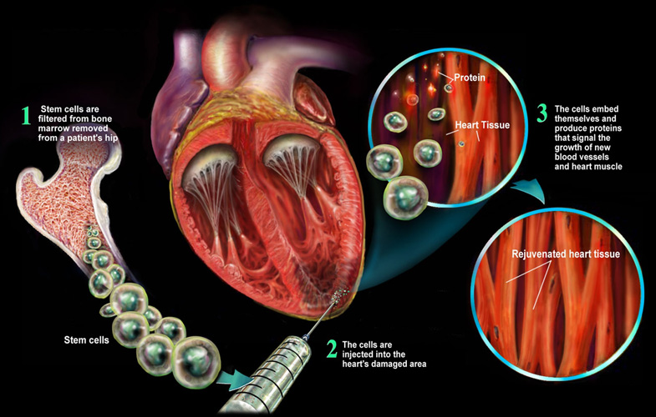
STEM CELLS
Undifferentiated cells, have the potential to develop into different cell types early in life and growth
They can be induced to form new tissues or organs

Slide 3
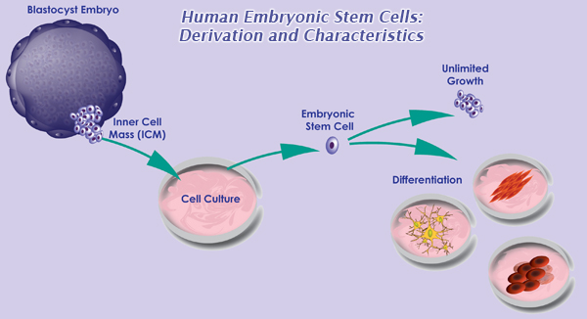
Embryonic Stem Cells
Harvested from a blastocyst- an embryo that is 4-5 days old
Pluripotent- Develop into all cell types except for the tissues surrounding the embryo
Donated for science from fertility clinics

Slide 4
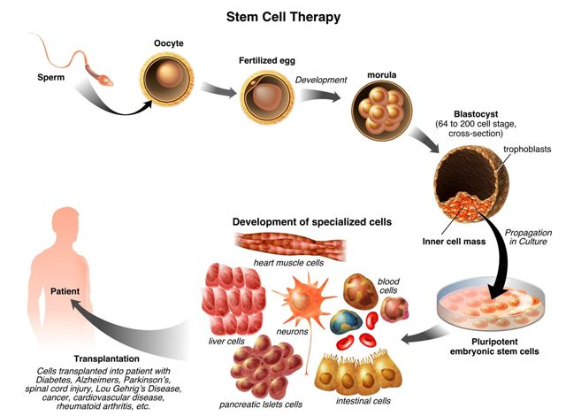

Slide 5
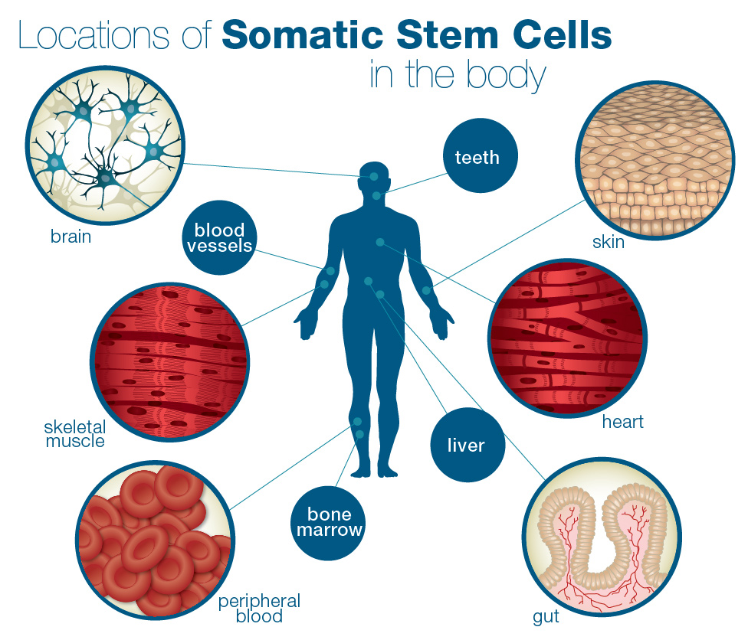
Somatic (adult) Stem Cells
Multipotent- develop into many type of differentiated cells, potential is limited but still promising
Harvested from patients needing treatment

Slide 6
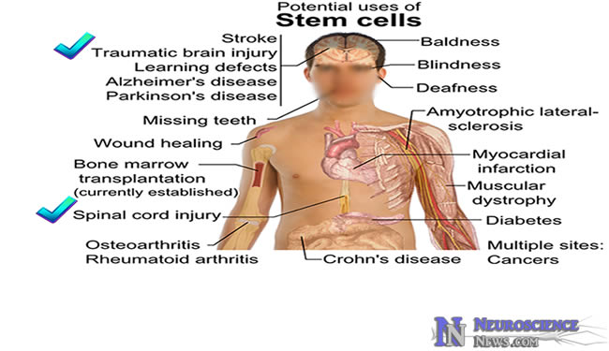
Potential Benefits
Treat cancer
Replace damaged tissues or organs
Treat heart disease: replacing damaged heart cells
Treat Parkinson’s, Alzheimer's

Slide 7
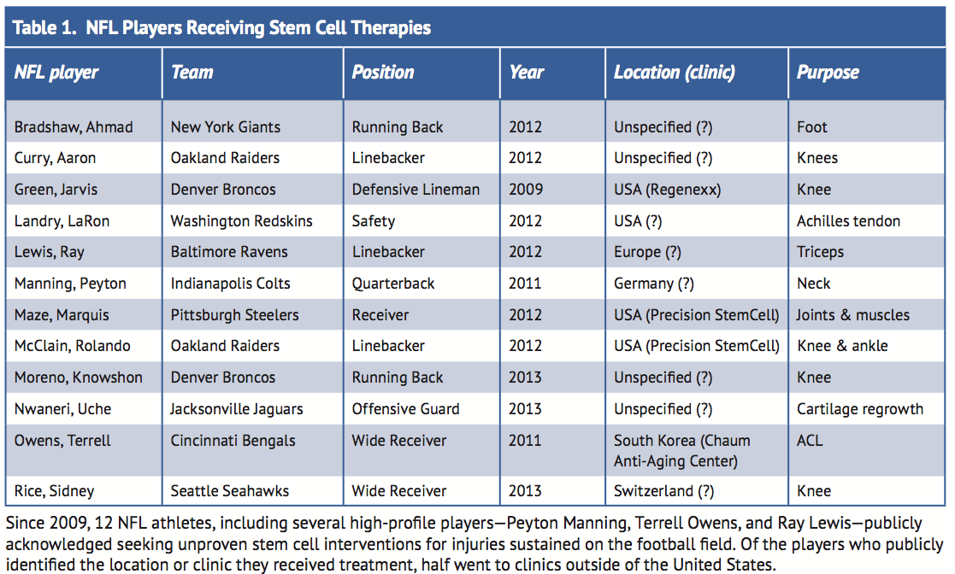
Advantages
No risk of rejection, cells are harvested from the patient
No risk of disease transmission
Anti-aging?

Slide 8
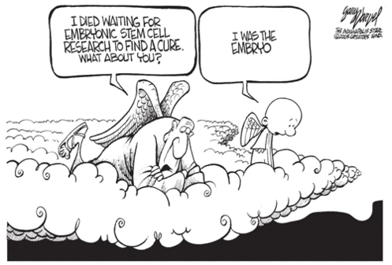
Ethical Issues
Destruction of an embryo
Difficulty getting government funding due to this
Involve life and death!

Slide 9
Short Video
http://www.pbs.org/wgbh/nova/body/stem-cells-breakthrough.html

